Slide 1



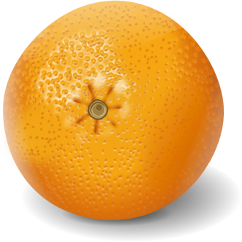

Tally Charts
Favourite Fruit

Slide 2



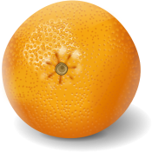

Are you ready to make your tally chart?
Fruit | Tally
apple
strawberry
banana
orange
grapes

Slide 33
Let’s check your answers.

Slide 34
Fruit | Tally
apple | llll l 6
strawberry | llll ll 7
banana | llll lll 8
orange | llll 4
grapes | llll 5

